Slide 1
#4 Neural NEtworks
Technical University of Kosice
Faculty of electrical engineering and informatics
Computer modelling

Slide 2
Overview
One time setup (activation functions, preprocessing, weight initialization, regularization, gradient checking)
Training dynamics (visualization of learning process, gaining insight, hyperparameter optimization)
Evaluation (model ensembles)

Slide 3
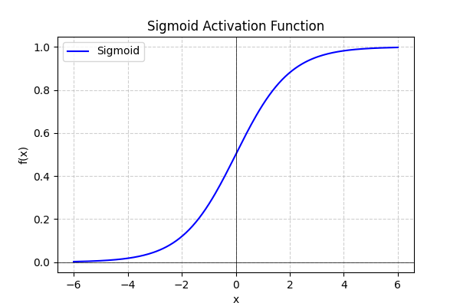
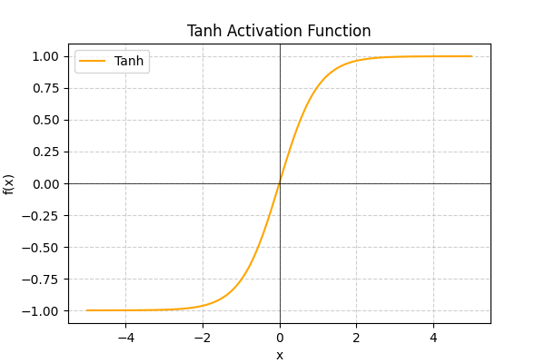
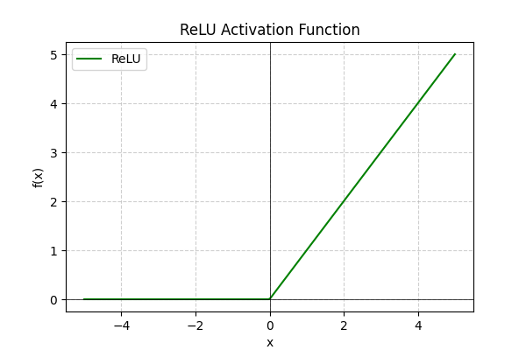
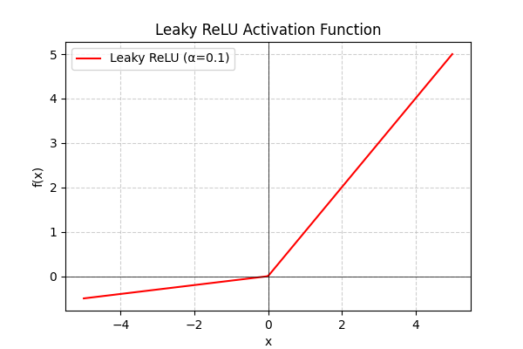
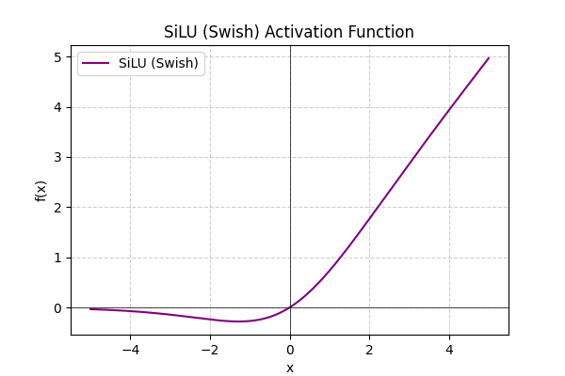
Activation functions
Sigmoid
tanh
ReLU
SiLU (Swish)
LeakyReLU

Slide 4

Sigmoid
$$σ(x) = 1/(1+e−x)$$
Squashes number into range [0, 1]
Saturating “firing rate of a neuron”
3 problems
Saturated neurons “kill” the gradient
Sigmoid outputs are not zero centered
Exp() is a bit compute expensive

Slide 5



Sigmoid gate
x
$$σ(x) = 1/(1+e−x)$$
$$\frac{∂L}{∂x}=\frac{∂σ}{∂x}∗\frac{∂L}{∂σ}$$
$$\frac{∂L}{∂σ}$$
X = 100, 0, -100?

Slide 6
Constraint in the gradients?
Optimal vector for update does not follow the “zigzag” pattern
Gradients are always all negative or all positive

Slide 7
Tanh activation function
Squashes numbers to range [-1, 1]
Zero centered
When saturated, still kills gradients

Slide 8
ReLU activation function (rectified linear unit)
f(x) = max(0, x)
Nice properties:
Does not saturate (in + region)
Very computationally efficient
Converges much faster than sigmoid/tanh in practice (6x)
Not zero-centered
Dead ReLU

Slide 9
Leaky relu activation function
f(x) = max(0.01x, x)
Does not saturate
Computationally efficient
Converges much faster than sigmoid/tanh in practice (6x)
Will not “die”

Slide 10

Silu activation function
$$f\left(x\right)=\frac{x}{1+e^{−x}}$$
Smooth & Non-Monotonic: The function is smooth everywhere (no sharp corner like ReLU). The small negative "bump" adds expressive power.
Unbounded Above
Outperforms ReLU
Computationally Heavier

Slide 11
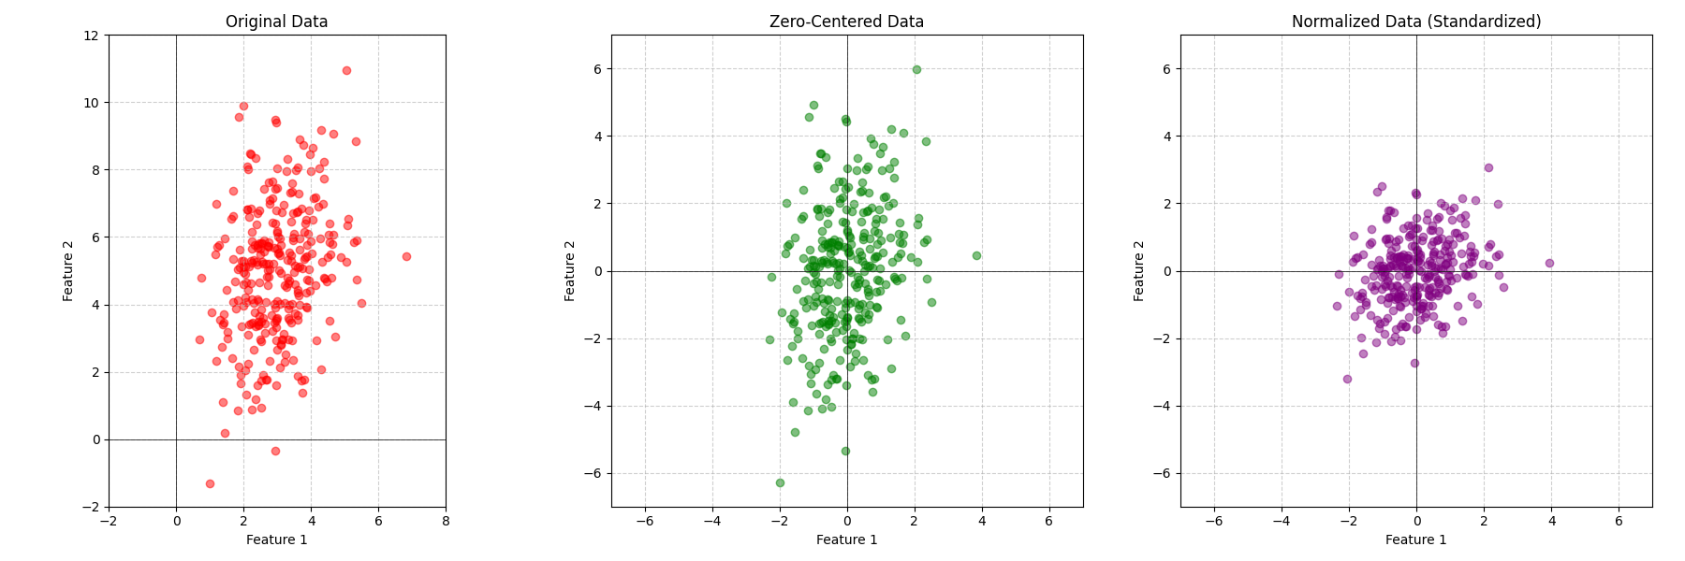
Preprocessing data

Slide 12
Weight initialization
W = 0 ?
Small Gaussian Initialization?
Large Gaussian Initializations?

Slide 13
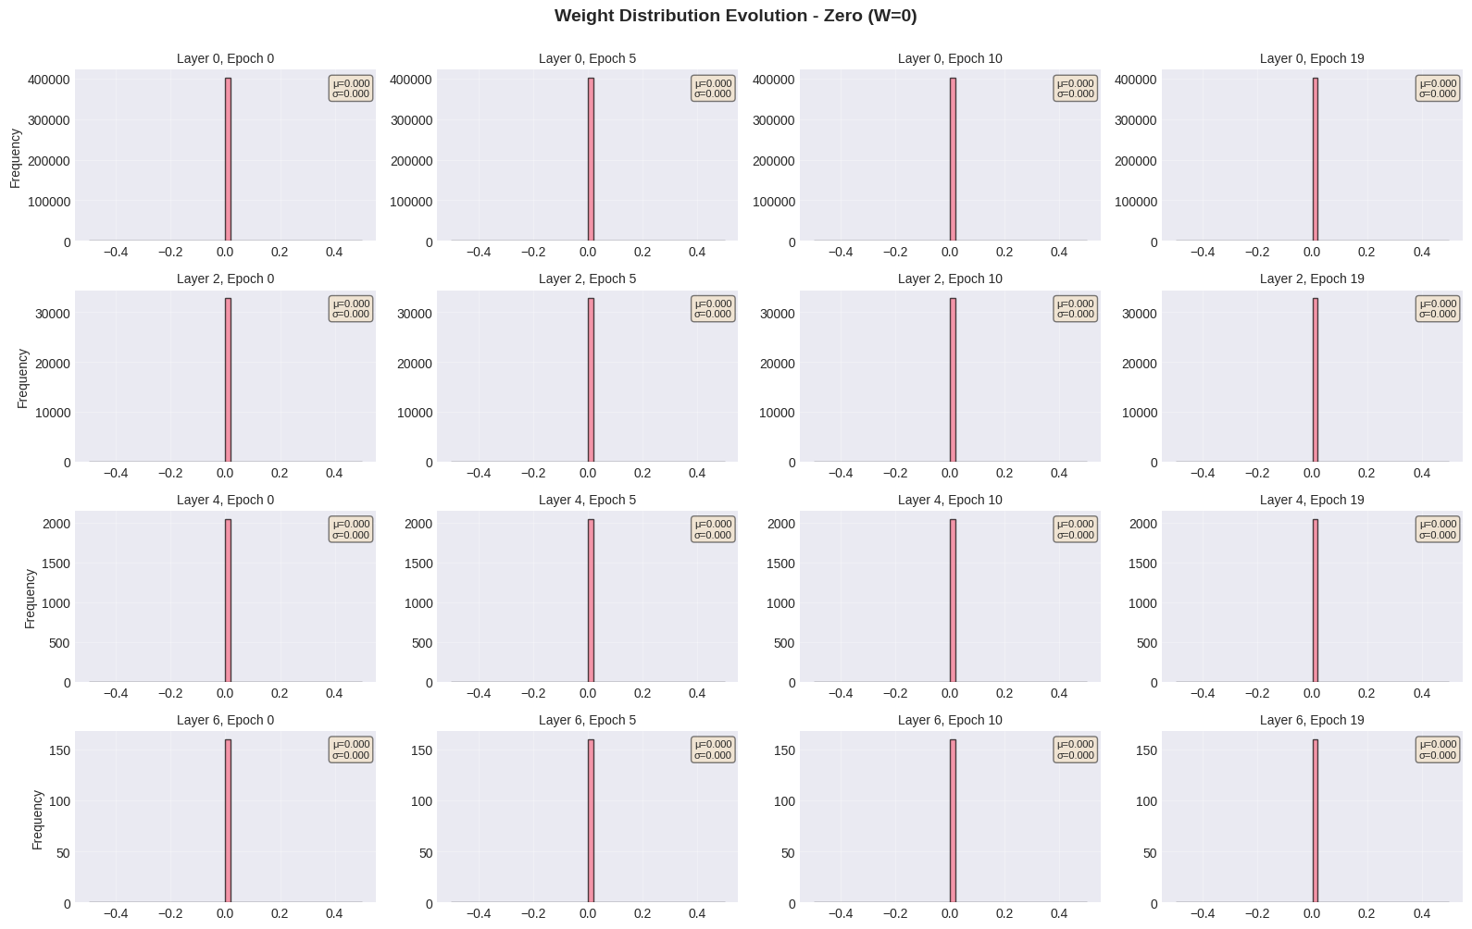

Slide 14
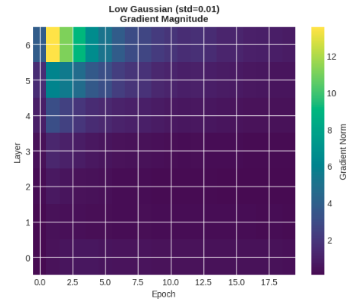
First idea (zero mean, 1e-2 std)
Gaussian distribution with zero mean and 1e-2 standard deviation
W = 0.01 * np.random.randn(d, h)

Slide 15
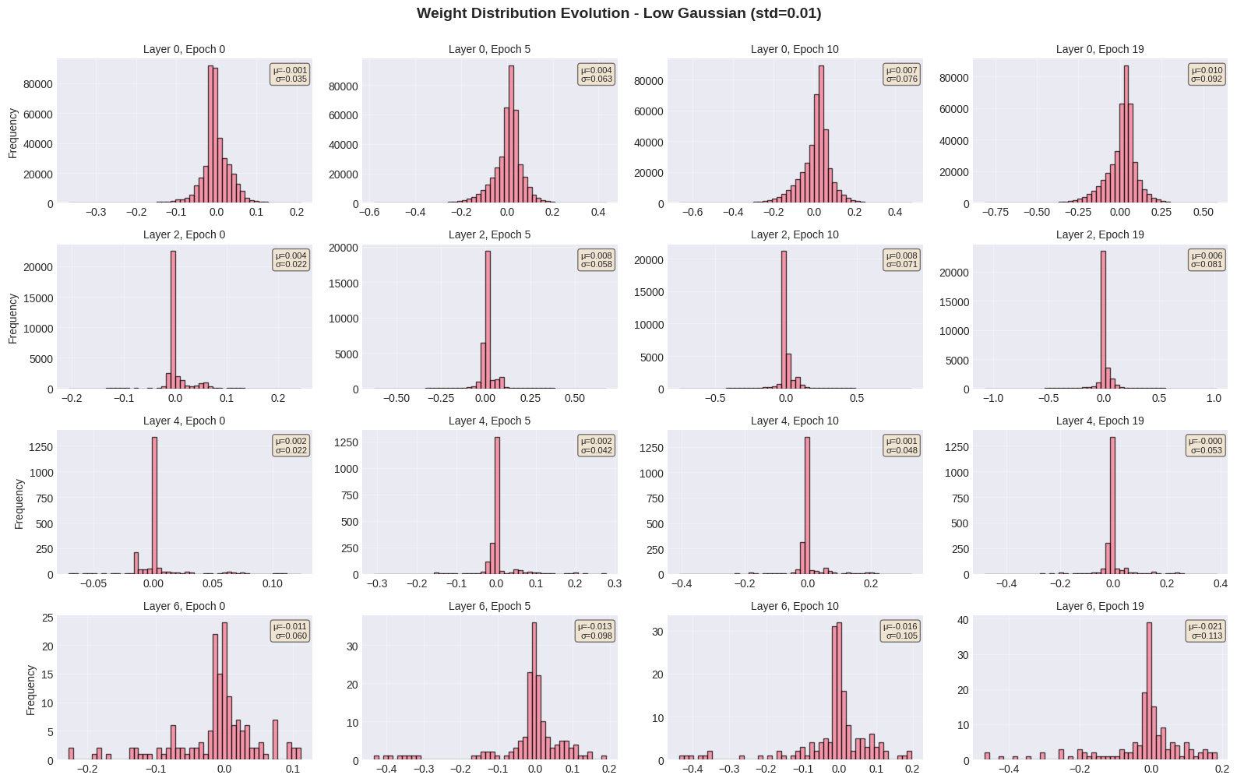

Slide 16
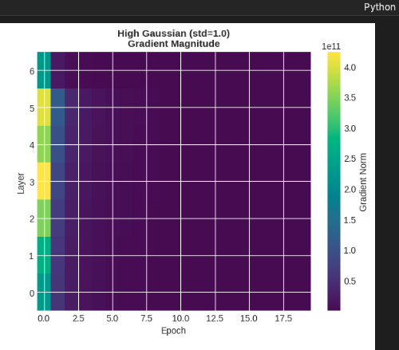
Second idea (zero mean, high gaussians std)

Slide 17
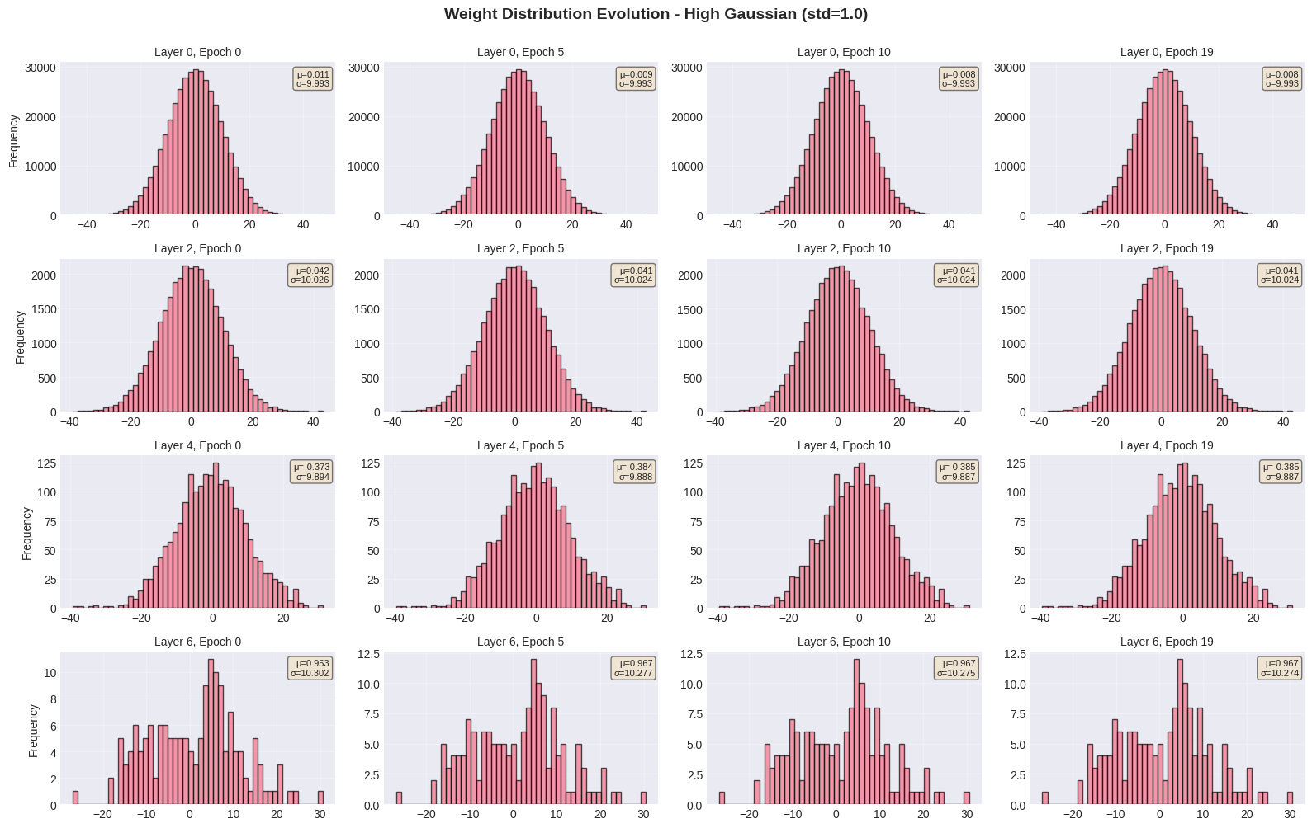

Slide 18
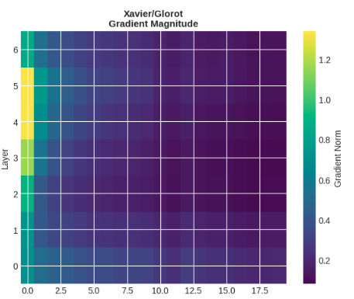
Xavier initialization
W = np.random.randn(fan_in, fan_out) / np.sqrt(fan_in)

Slide 19
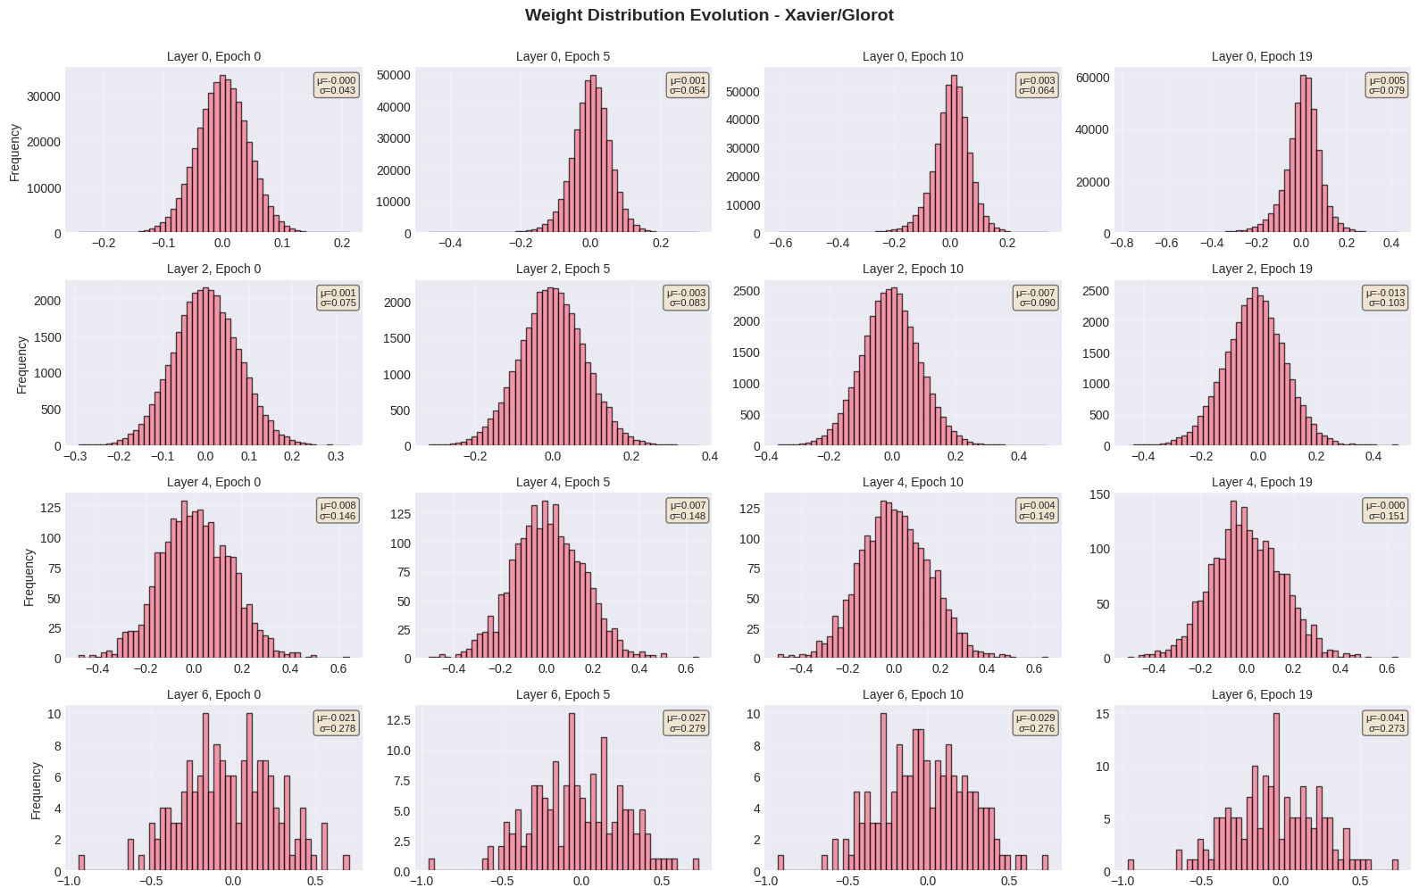

Slide 20
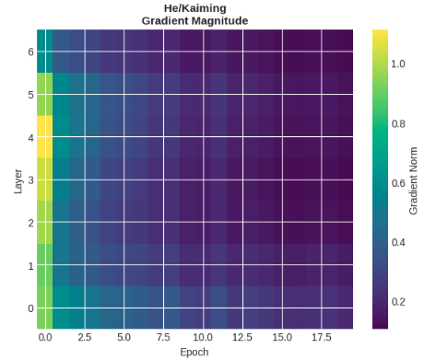
Kaiming/he initialization
W = np.random.randn(fan_in, fan_out) / np.sqrt(fan_in/2)

Slide 21
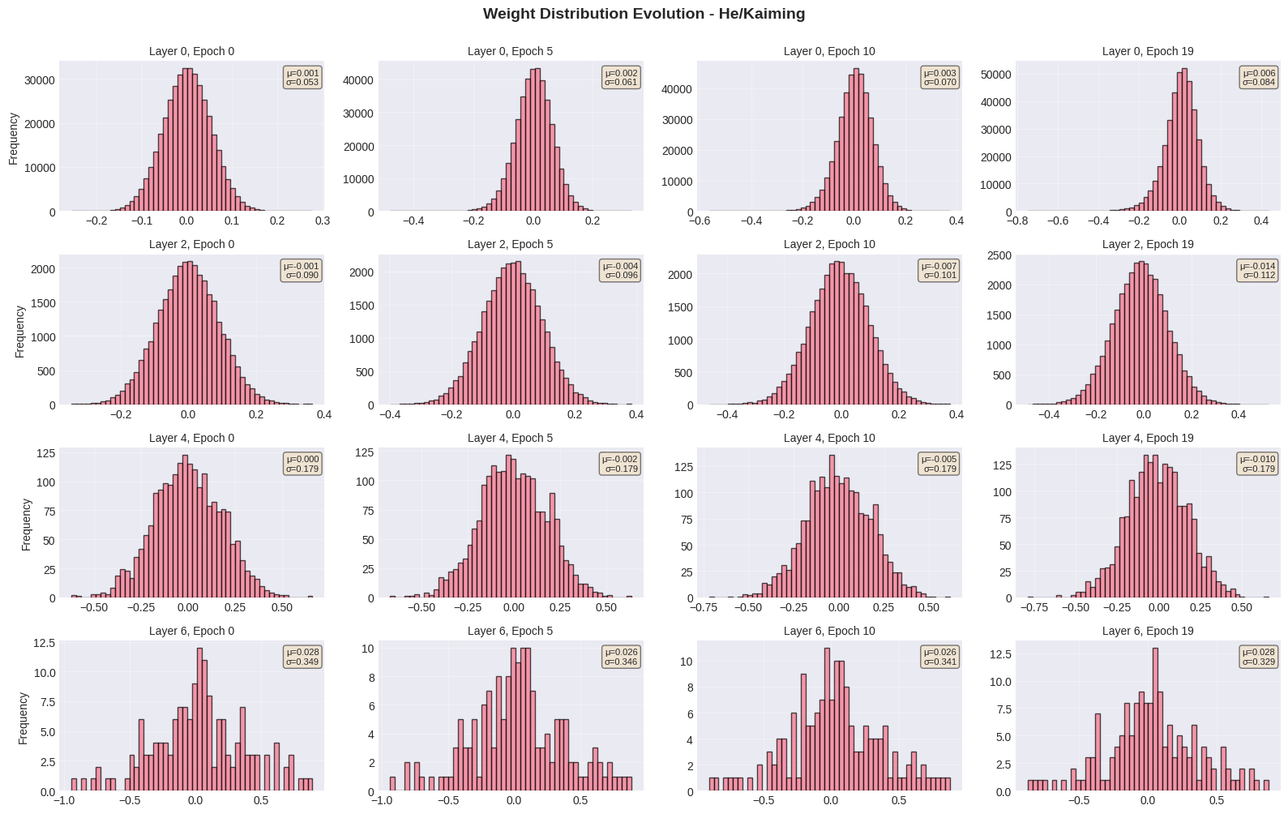

Slide 22
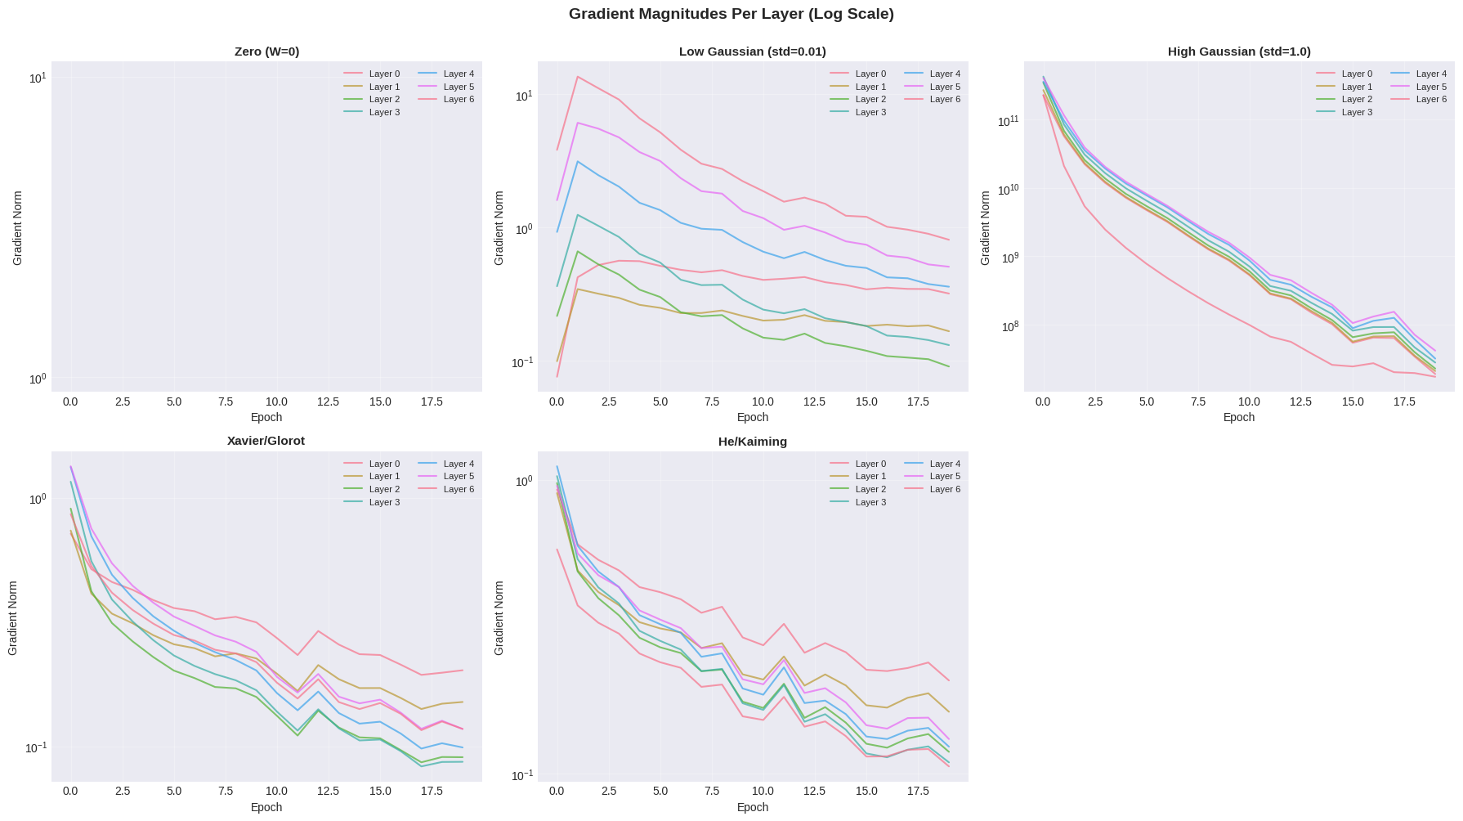

Slide 23
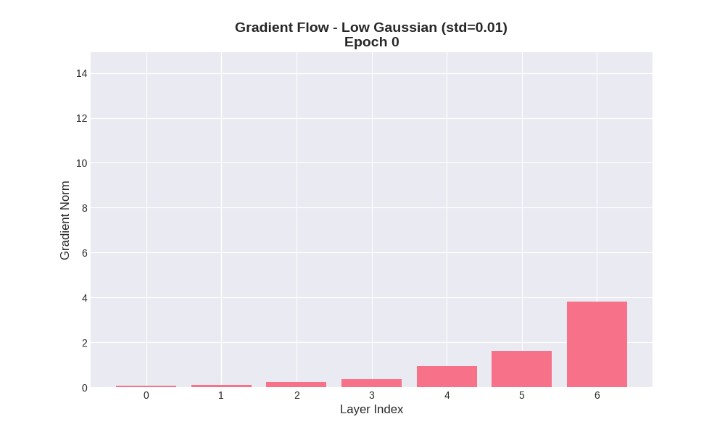
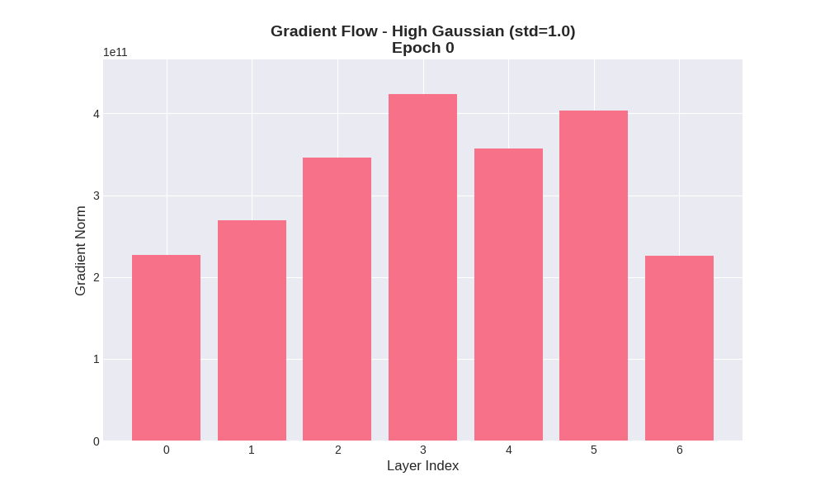
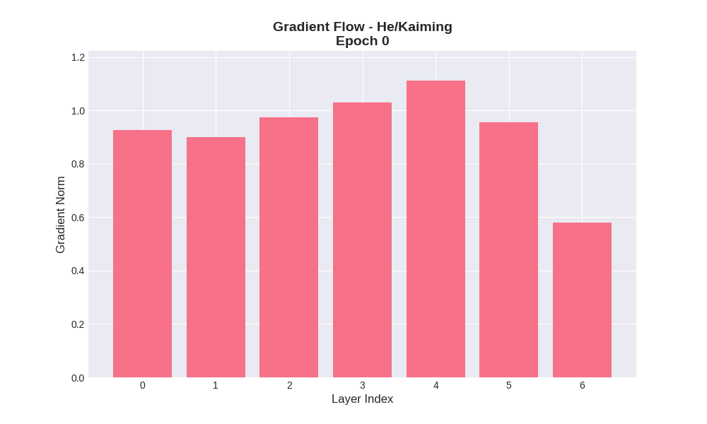

Slide 24
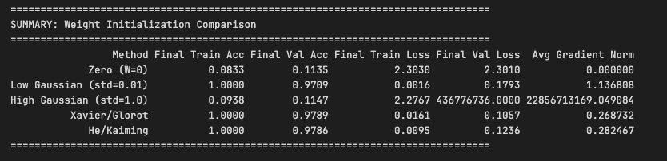

Slide 25
optimizers

Slide 26
Mini-batch stochastic gradient descent
Loop:
Sample batch of data
Forward function to obtain loss
Backward function to calculate gradients
Update the parameters using the gradients
x
y
z

